Slide 1

cv
Image Fusion of low-light visible and thermal Infrared images based on a novel Hybrid MSD approach
Team Members
Nitin P Khatawate
Soumil Biswas
ShivPrasad Achari
Tanish V Sugnani
Under the Guidance of:
Dr. Shubha Bhat Mr. Sasidhar B
Associate Professor, Asst. Professor,
Dept. of CSE Dept. of CSE
Department of Computer Science & Engineering, DSCE

Slide 2
Contents
Introduction
Flowchart
Code Snippet
Experimental Results
Graphical Representation of Results

Slide 3
cv
INTRODUCTION
In computer vision, Multisensor Image fusion is the process of combining relevant information from two or more images into a single image. The resulting image will be more informative than any of the input images.
Real-time implementation of the dual sensor fusion system combines imagery from either a low-light CCD camera or a short-wave infrared camera, with thermal long-wave infrared imagery.
Department of Computer Science & Engineering, DSCE

Slide 4
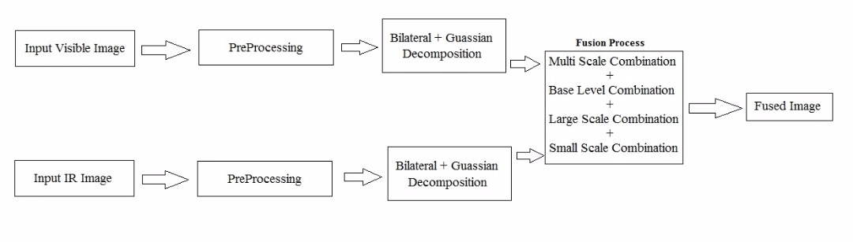
cv
FLOWCHART
Department of Computer Science & Engineering, DSCE

Slide 5
cv
CODE SNIPPET
Hybrid MSD
Code for multi scale decomposition of image using Gaussian and Bilateral filter
M1 = cell(1, nLevel+1);
M1L = cell(1, nLevel+1);
M1{1} = img1;
M1L{1} = img1;
M1D = cell(1, nLevel+1);
M1E = cell(1, nLevel+1);
sigma0 = sigma;
for j = 2:nLevel+1,
w = floor(3*sigma0);
h = fspecial('gaussian', [2*w+1, 2*w+1], sigma0);
M1{j} = imfilter(M1{j-1}, h, 'symmetric');
M1L{j} = 255*bfilter2(M1L{j-1}/255,w,[sigma0, sigma_r/(k^(j-2))]);
M1D{j} = M1{j-1} - M1L{j};
M1E{j} = M1L{j} - M1{j};
sigma0 = k*sigma0;
end
Department of Computer Science & Engineering, DSCE

Slide 6
cv
CODE SNIPPET
Code for Bilateral filter
dim = size(A);
B = zeros(dim);
for i = 1:dim(1)
for j = 1:dim(2)
% Extract local region.
iMin = max(i-w,1);
iMax = min(i+w,dim(1));
jMin = max(j-w,1);
jMax = min(j+w,dim(2));
I = A(iMin:iMax,jMin:jMax);
% Compute Gaussian intensity weights.
H = exp(-(I-A(i,j)).^2/(2*sigma_r^2));
% Calculate bilateral filter response.
F = H.*G((iMin:iMax)-i+w+1,(jMin:jMax)-j+w+1);
B(i,j) = sum(F(:).*I(:))/sum(F(:));
end
end
Department of Computer Science & Engineering, DSCE

Slide 7
cv
CODE SNIPPET
Code for image fusion
%Base level combination
if j == nLevel+1
w = floor(3*sigma0);
h = fspecial('gaussian', [2*w+1, 2*w+1], sigma0);
lambda_Base = lambda;
C_N = atan(lambda_Base*P_j)/atan(lambda_Base);
C_N = imfilter(C_N, h, 'symmetric');
MF = C_N.*M2{j} + (1-C_N).*M1{j};
end
% Large-scale combination
sigma0 = 1.0;
w = floor(3*sigma0);
h = fspecial('gaussian', [2*w+1, 2*w+1], sigma0);
C_j = imfilter(C_j, h, 'symmetric');
D_F = C_j.*M2E{j}+ (1-C_j).*M1E{j};
MF = MF + D_F;
D_F = C_j.*M2D{j}+ (1-C_j).*M1D{j};
MF = MF + D_F;
end
Department of Computer Science & Engineering, DSCE

Slide 8
cv
CODE SNIPPET
% Small-scale combination
sigma0 = 0.5;
w = floor(3*sigma0);
h = fspecial('gaussian', [2*w+1, 2*w+1], sigma0);
C_0 = double(abs(M1E{2}) < abs(M2E{2}));
C_0 = imfilter(C_0, h, 'symmetric');
D_F = C_0.*M2E{2}+ (1-C_0).*M1E{2};
MF = MF + D_F;
C_0 = abs(M1D{2}) < abs(M2D{2});
D_F = C_0.*M2D{2}+ (1-C_0).*M1D{2};
MF = MF + D_F;
Department of Computer Science & Engineering, DSCE

Slide 9
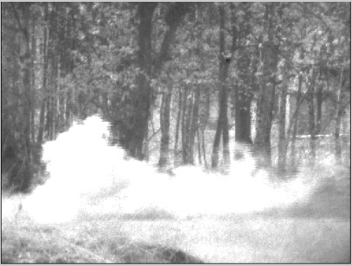
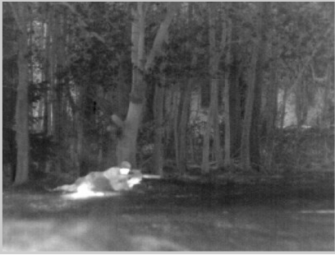
INPUT IMAGES
Visible Image
IR Image

Slide 10
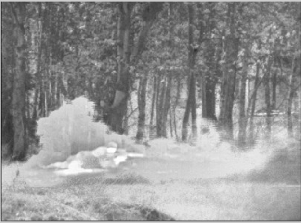
cv
Output
Department of Computer Science & Engineering, DSCE

Slide 11
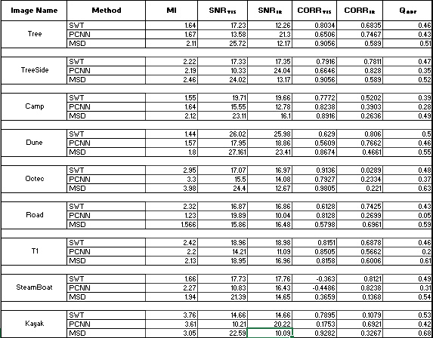
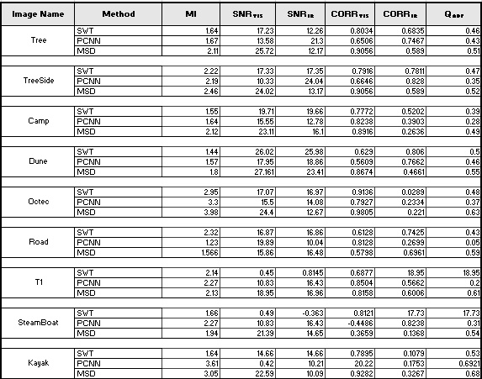

Slide 12
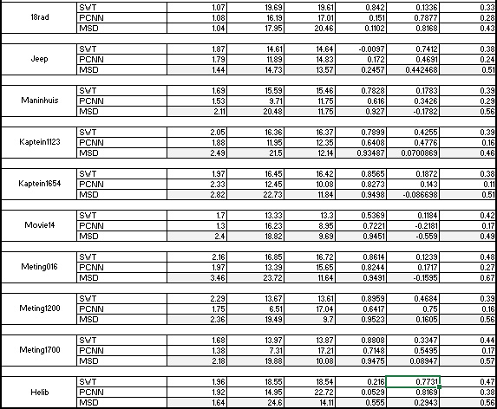

Slide 13
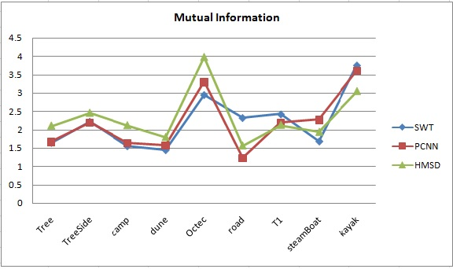
cv
RESULTS
Department of Computer Science & Engineering, DSCE

Slide 14
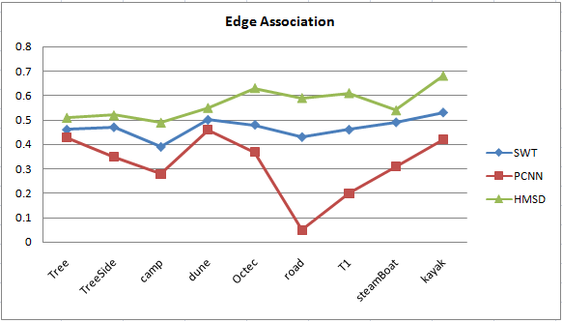
cv
RESULTS
Department of Computer Science & Engineering, DSCE

Slide 15
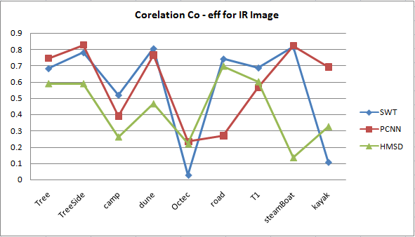
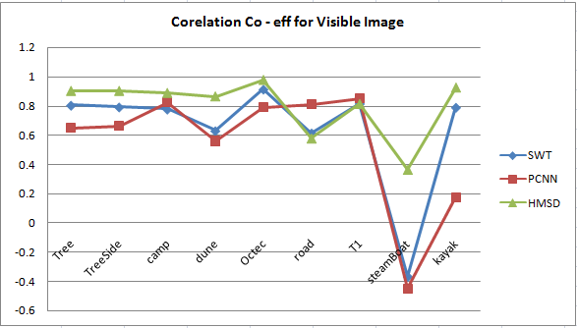
cv
RESULTS
Department of Computer Science & Engineering, DSCE

Slide 16
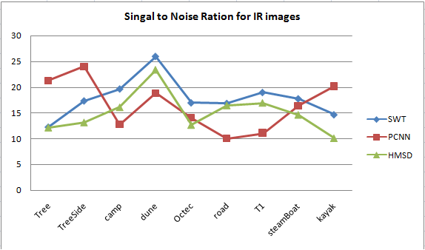
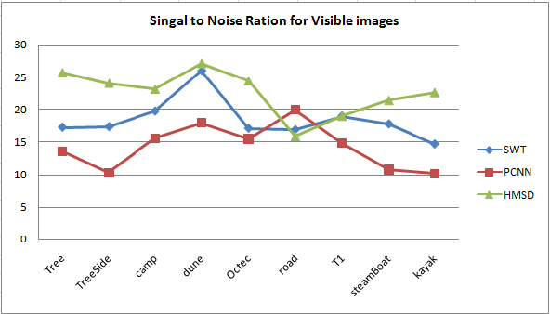
cv
RESULTS
Department of Computer Science & Engineering, DSCE

Slide 17
cv
THANK YOU
Department of Computer Science & Engineering, DSCE

